Slide 1
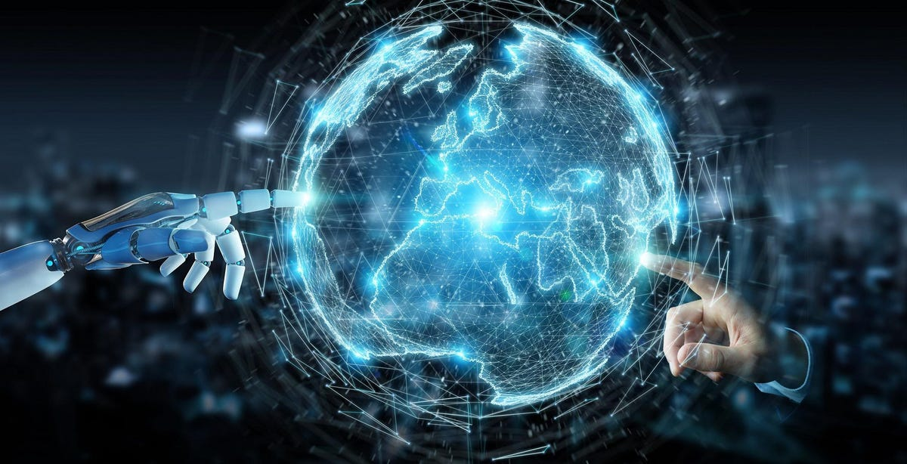
Prime Minister Hunarmand’s Pakistan Program 2022 – Batch III
“Artificial Intelligence”
Sahibzada Muhammad Salman
Artificial Intelligence Engineer - EncoderBytes (PRIVATE) LIMITED.

Slide 2
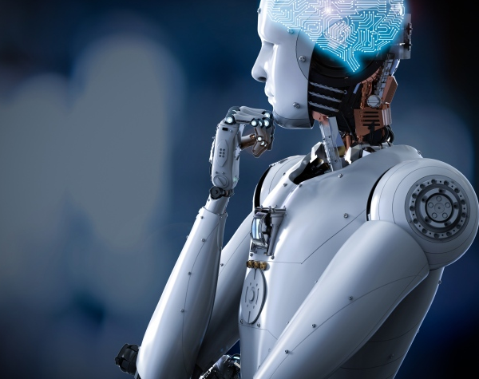
Outline
Computer Language
Communicating with Computers
Programming
Why Programming?
Programming Languages
Life of a Programmer :p
Programming Languages for ML/AI
Python
Why Python
Anaconda
Installation
Python Fundamentals
Basic Data Types

Slide 3
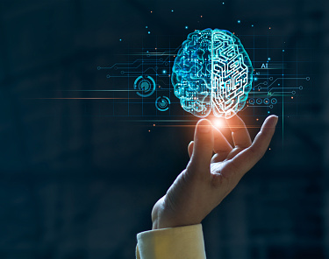
Computer Language
We as humans, need a way to communicate/interact with each other.
Today 95% of communication is done via audio/speech/discourse.
Just as we require a language to communicate with each other, computers also require a language to communicate.
We call their language as “Computer language”

Slide 4
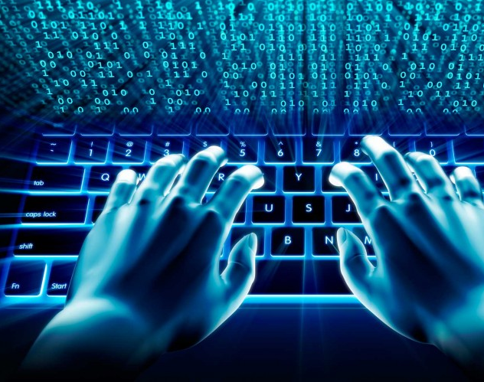
Why do we need to communicate with computers?
We need a way to communicate with computers in order to instruct them to perform various tasks.
For this we need a language which computers can understand
These languages are often referred as programming languages

Slide 5
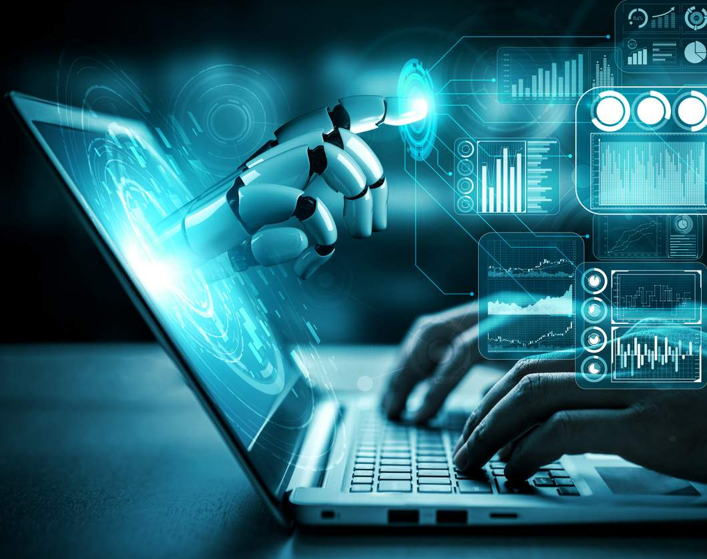
What is Programming?
Programming is a way “to instruct the computer to perform various tasks”
Now what does “instruct the computer” means?
Instruct basically means that you provide the computer a set of instructions that are written in a language that the computer can understand.
The instructions can be anything, for instance;
Adding/Subtracting/multiplying/dividing numbers
Reading/Writing files
Automating tasks, such as email reminders, message sending, calculate interests, access files, collect/retrieve/manipulate files, images, videos, music, etc.
Programming is a way to tell computers to perform certain tasks.

Slide 6
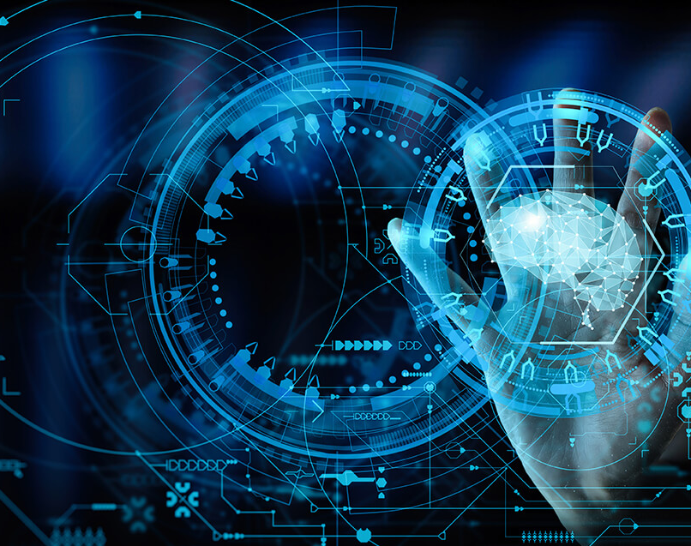
Why should we even bother programming?
We need computers to do certain tasks due to various reasons such as;
Computers are fast: they can do calculations the very difficult or impossible for humans to do manually.
For example, a computer can perform billion additions in a second which is impossible for humans to do.
Computers can process huge amount of information quickly and reliably
Computers are cheap: Computers are inexpensive enabling us to automate various tasks such market analysis, hardcore calculations, store and process gigabytes of data etc. All this for a cost that totally worth it.
Computers can work all day long: Computers can work 24/7 without getting exhausted. Thus enabling us to do hectic tasks without any worries.

Slide 7
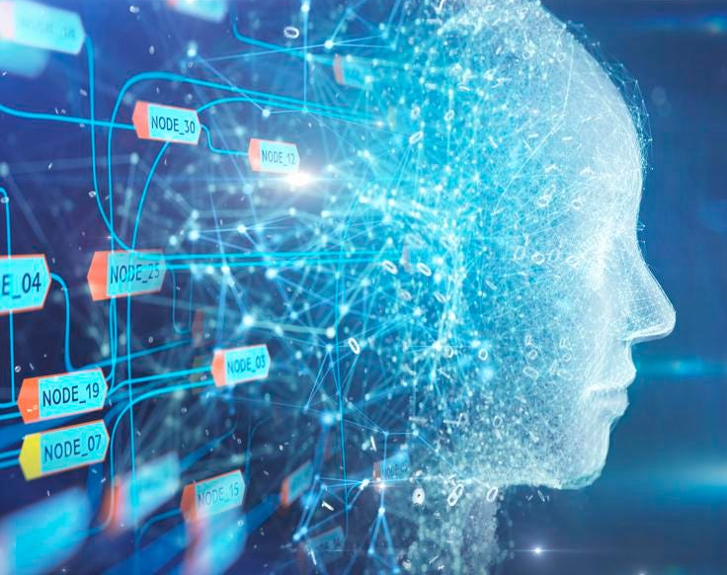
Programming Languages
Programming languages are a set of instructions that are written in specific syntactical form in order to tell computers to perform certain task/tasks.
Programming languages enable us to develop complex graphics, shapes, develop web pages, smartphone applications, automate various tasks like automatic pet feeder, virtual assistants to control house holds, collect/store/retrieve data from almost anywhere.
There are numerous uses of programming languages which include web development, application development, blockchain development, game development, machine learning, data science, collecting/storing/retrieving data etc.
There aur numerous programming languages, the most popular ones are; Java, Java script, HTML, CSS, C++, C, Swift, SQL, Python, and Ruby.

Slide 8
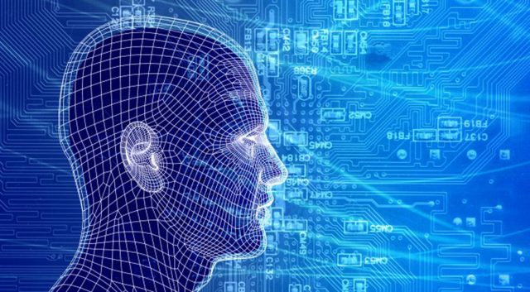
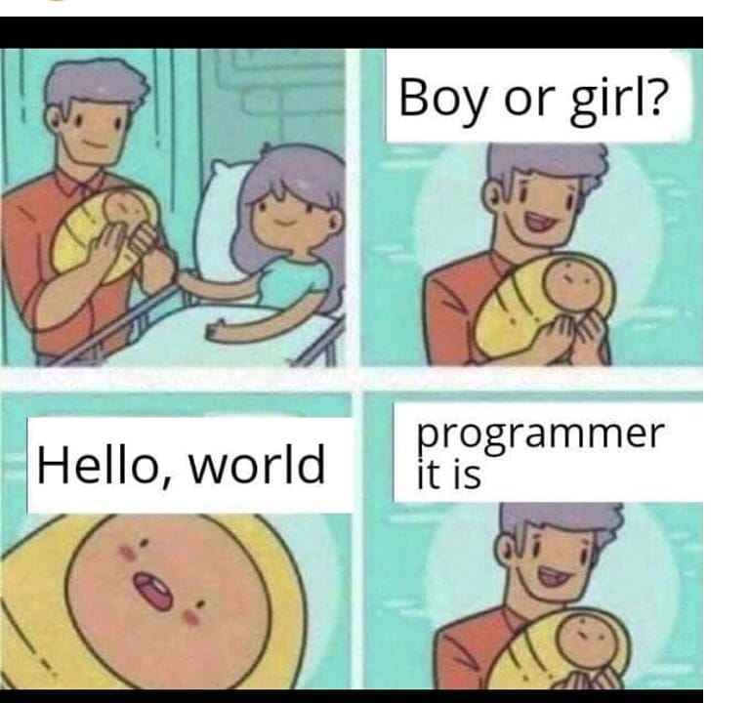
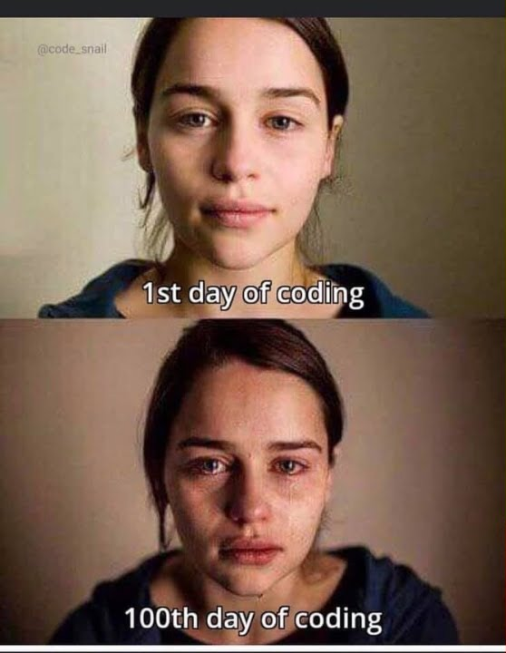
Life of a Programmer

Slide 9
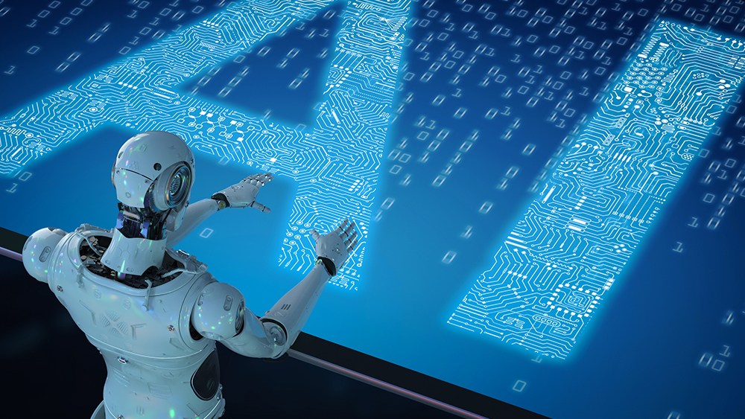
Work life of a Programmer

Slide 10
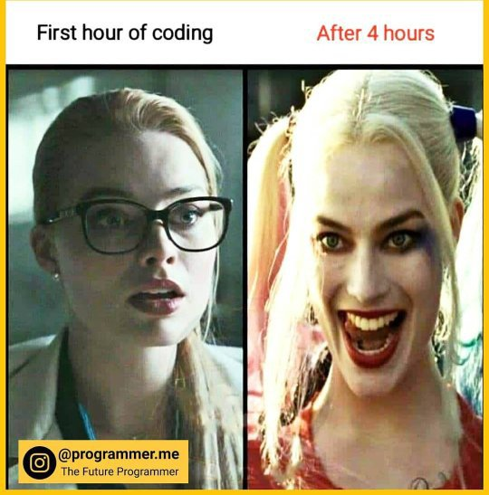

Slide 11
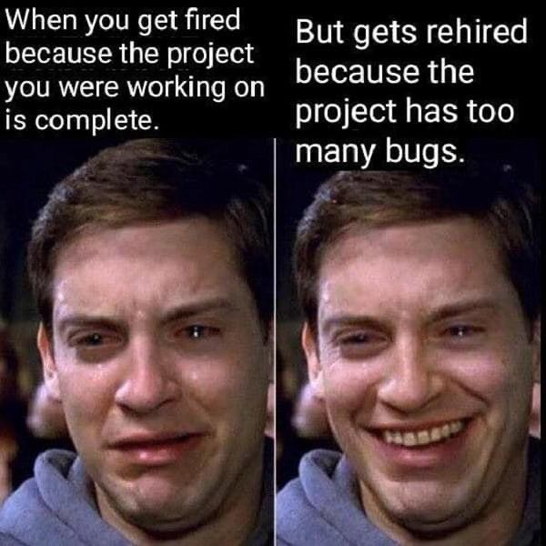

Slide 12
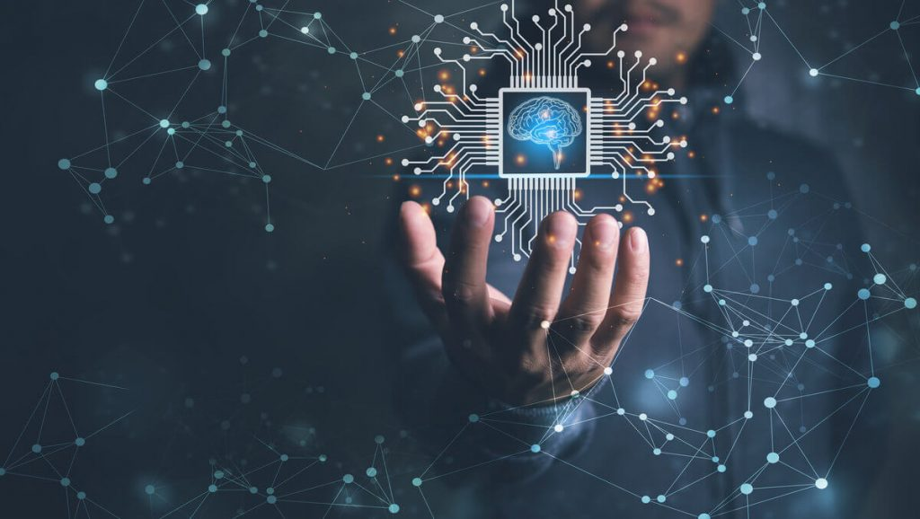
Which Language will we use for ML?
There are numerous languages and the most famous ones are;
Python
R Programming
Java/JavaScript
Julia
LISP

Slide 13
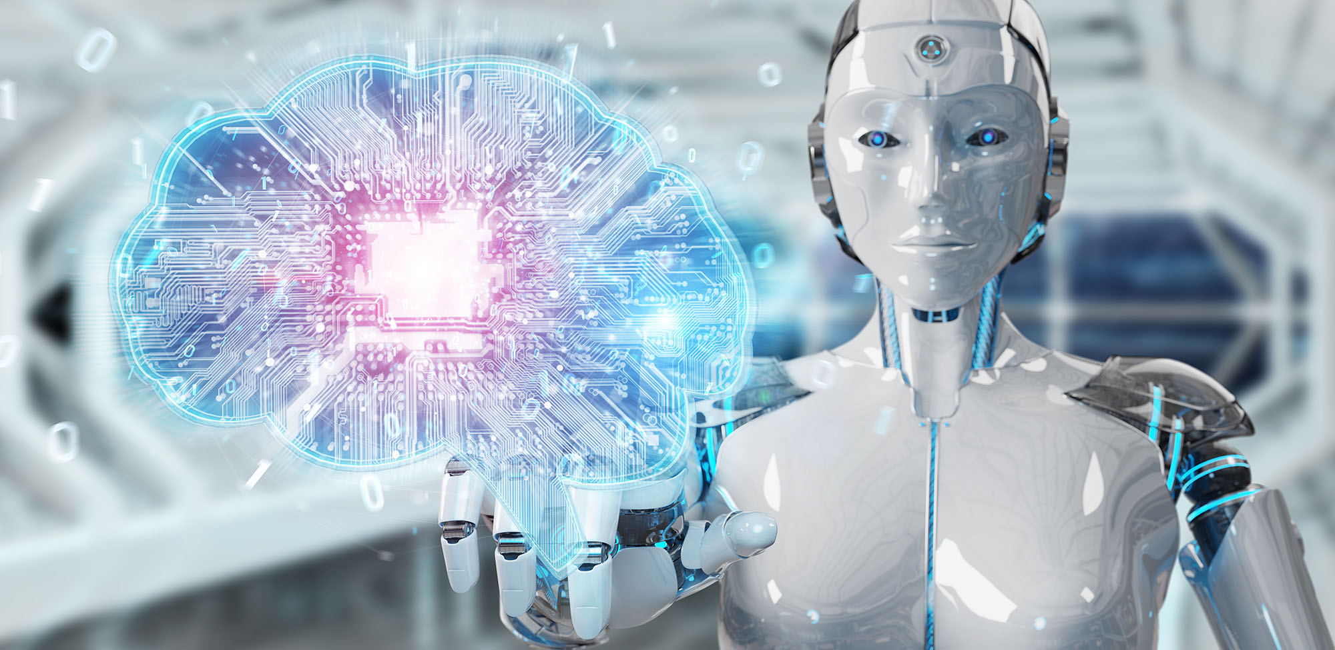
Python

Slide 14
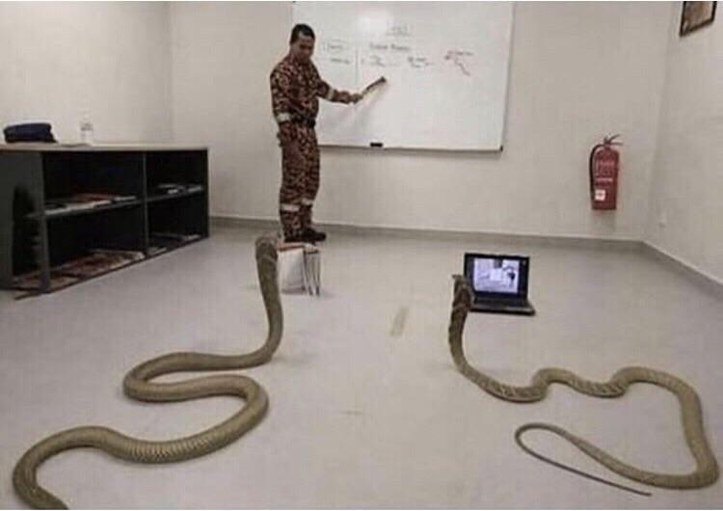
Python Programming

Slide 15
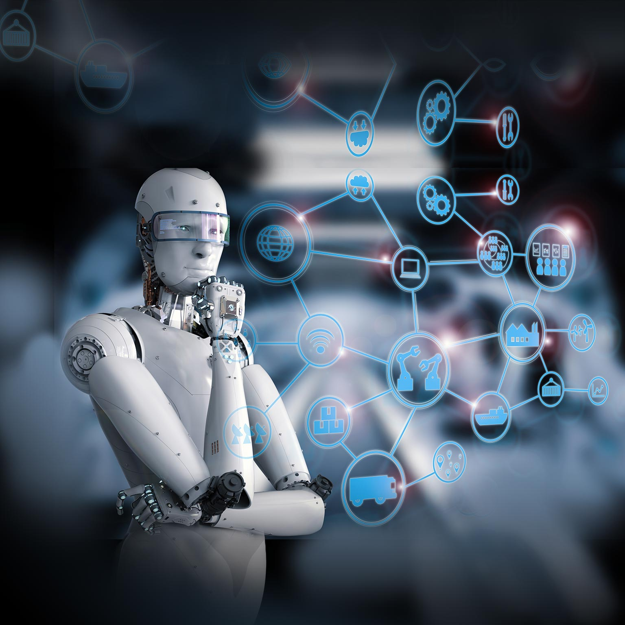
Why Python?
Python is the best and by far the most popular language for machine learning, data science, and scientific computing.
The Main Reasons;
Very easy to read and write code (compact syntax)
No compilation! Only interpretation
A plethora of libraries and packages
Open Source
Primarily used by all the tech giants around the globe including, Google, Amazon, Facebook, Netflix, Instagram, Dropbox, YouTube, Uber, and Reddit.
Heavily used in
Machine learning
Data Science
Scientific Computing

Slide 16
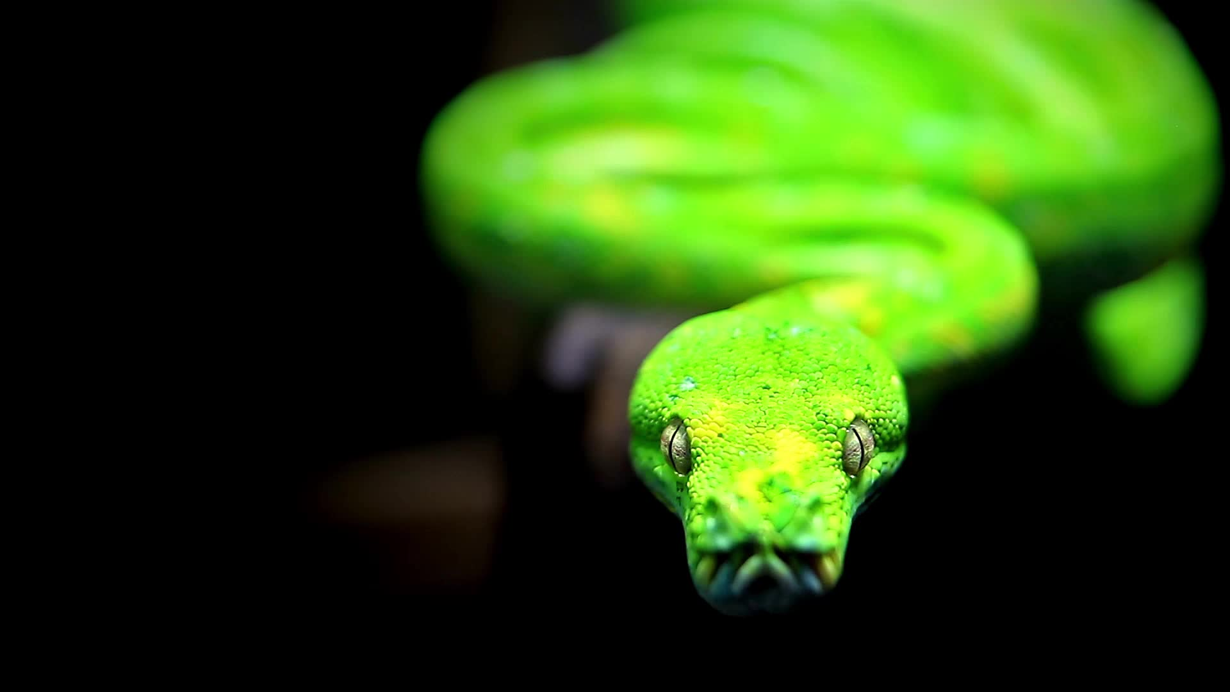
Why Python?

Slide 17
Code for asking user to enter his/her name and then displaying the result on screen
C++ | Java | Python
#include #include using namespace std; int main() { string name; cin >> name; cout << "Good evening, " << name << endl; return 0; } | import java.util.Scanner; public class GetIpAddress { public static void main(String args[]) throws Exception { String name; Scanner SC=new Scanner(System.in); System.out.print("Enter name: "); name= SC.nextLine(); System.out.println(“Good evening: " + name); } } | name = input() print("Good evening, " + name)

Slide 18
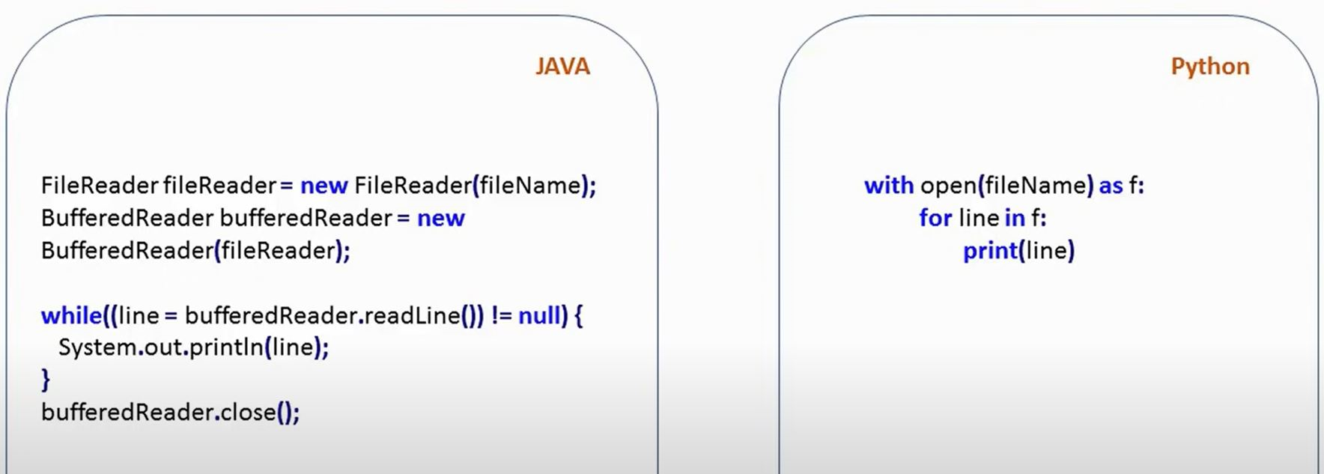
Opening file in Java vs Python

Slide 19
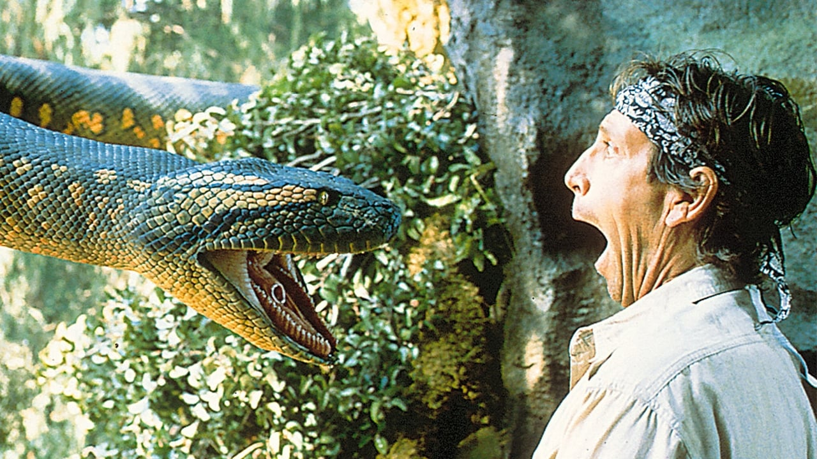
Anaconda

Slide 20
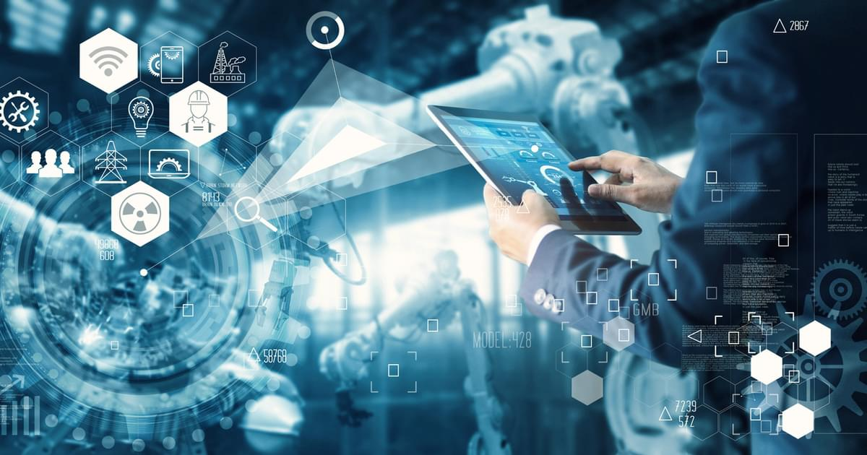
Anaconda
Anaconda is a distribution for Python and R language computing
It allows simplified package management and deployment
We will looking at how to install anaconda on your device
And how to configure environments for your different projects.

Slide 21
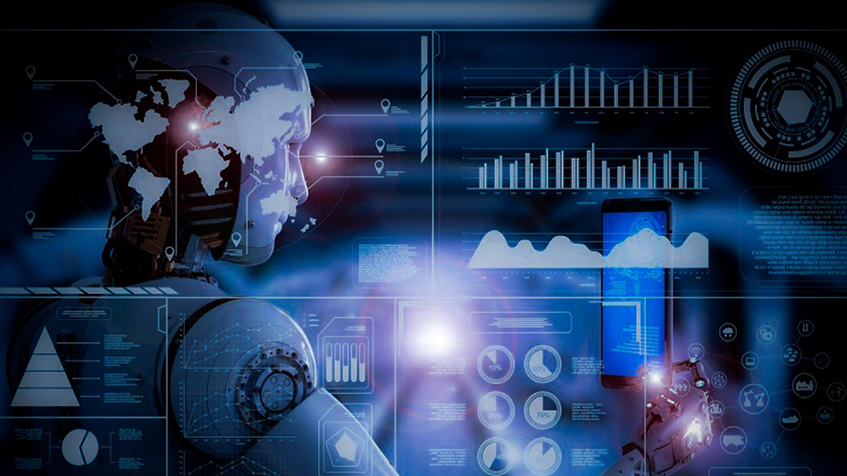
How to install Anaconda?
Simply type anaconda on your browser
Select Individual Edition
Download Anaconda Individual Edition w.r.t your Os (either windows, mac os or Linux)
For this particular course I’ll be using windows.
Install the distribution
Let’s set up the environment!

Slide 22
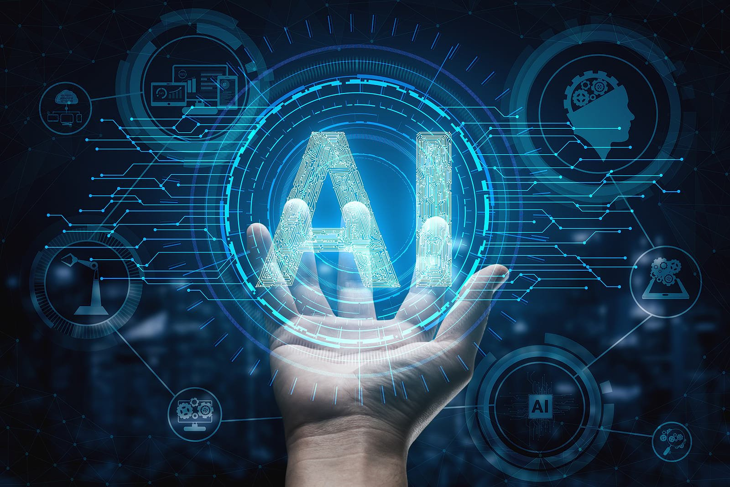
Setting Up Environment
https://docs.conda.io/projects/conda/en/latest/user-guide/getting-started.html

Slide 23
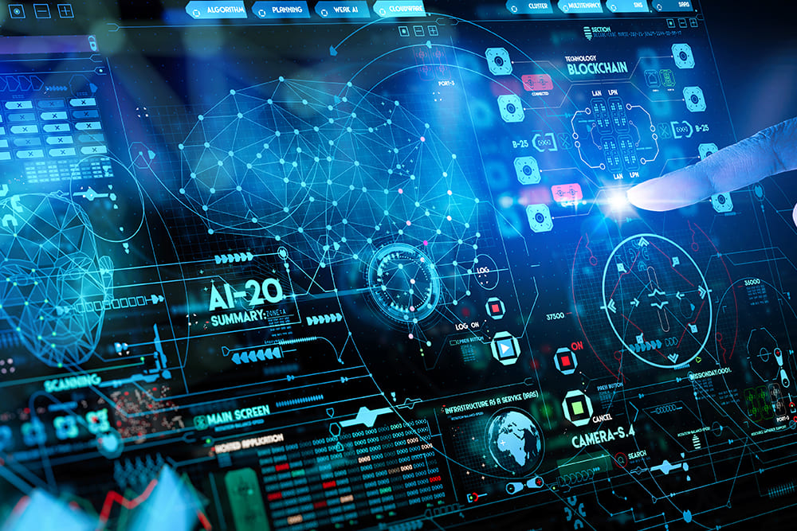
Python Programming Fundamentals

Slide 24

Basic Python Data Types
So the first question you might be wondering, what is a “data type”?
Data type is a label that tells a computer how to interpret its value
For example, integer data type tells computer that it is an integer
A “float” tells it’s a number with decimal!
Boolean tells the computer that it’s a binary statement! Either “true or false”, “Yes or No”, “0 or 1”

